Slide 1

Basic Details of the Team and Problem Statement
Ministry/Organization Name/Student Innovation:
All India Council for Technical Education (AICTE)
PS Code: DR702
Problem Statement Title: AI based Chatbot to answer FAQs
Team Name: Tech-Dudes
Team Leader Name: Rohit Sahu
Institute Code: C-36219
Institute Name: Institute of Technology and Management, Gwalior
Theme Name: Smart Automation

Slide 2
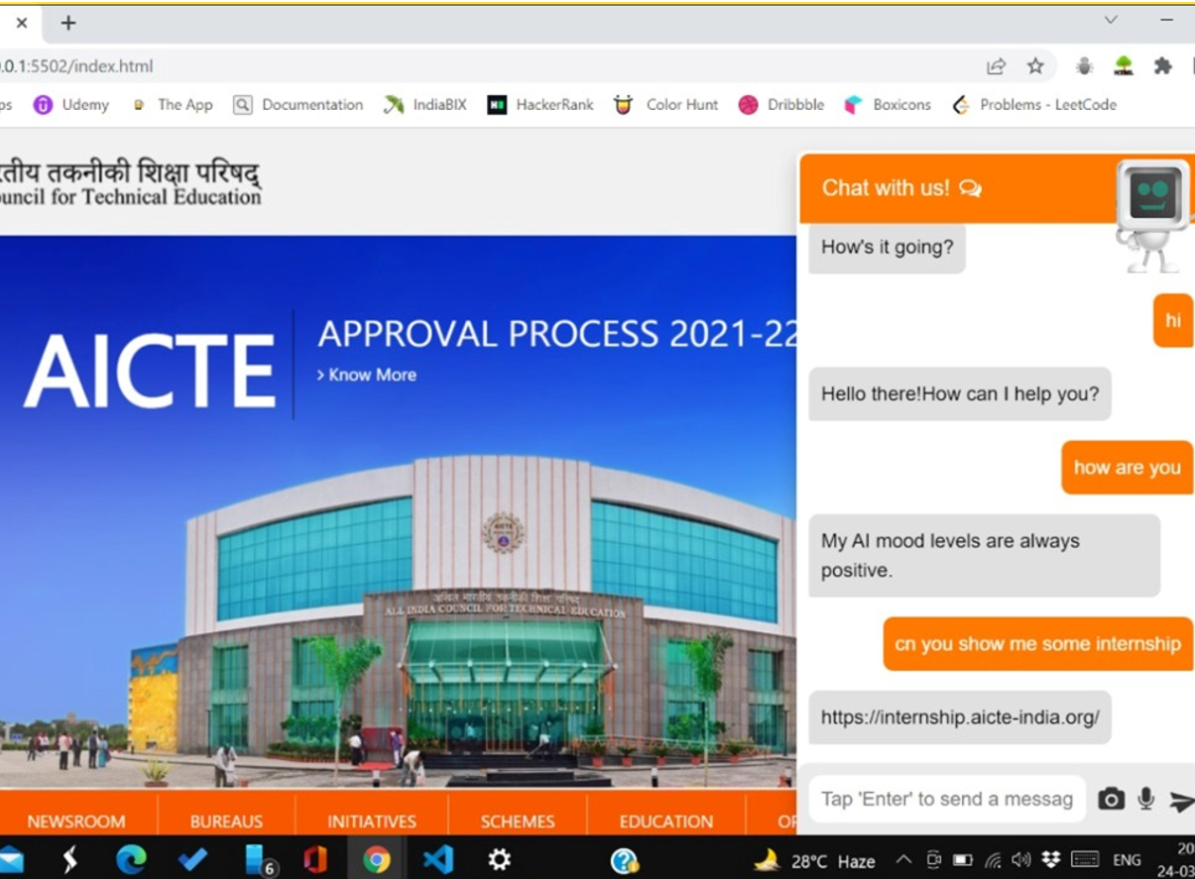
Idea/Approach Details
Describe your idea/Solution/Prototype here:
Our solution comprising of a Chat Bot Assistant with home page. This Chat Bot can reply the visitor’s queries in the form of voice & text simultaneously through an Animated character.
Replies also can be returned in form of images, animated images(GIFs, flash). If the required content collected from different websites, then user can be re-directed through provided hyperlinks.
In addition if the reply is an process it will present in form of “Animated Flow Diagram”. The primary key to extract the information from this Bot is user’s voice.
However ,he/she may ask the Bot by pasting an image from the clipboard.
Describe your Technology stack here:
Front End : HTML, CSS & JavaScript
Back End : Flask & Stream Lit
Database : SQL
Machine Learning
Deep Learning : CNN
Natural Language Processing

Slide 3
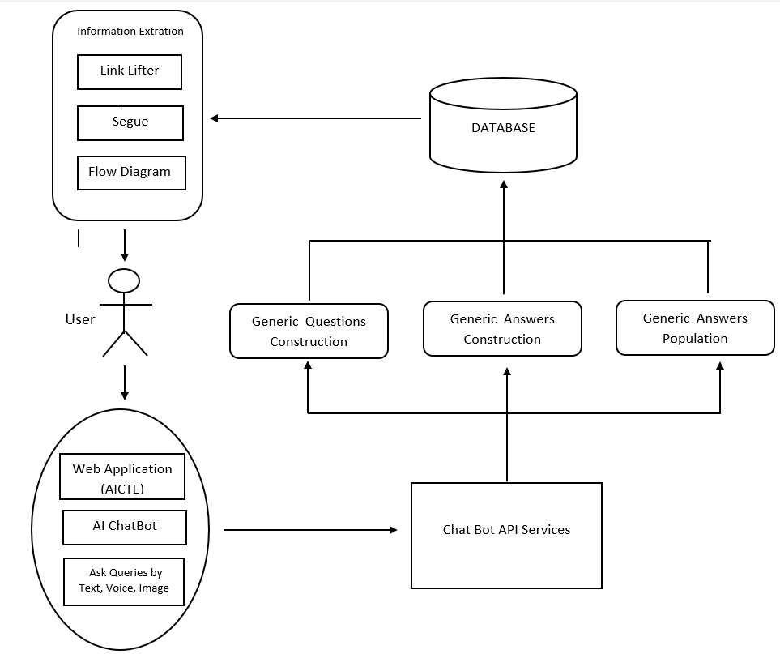
Idea/Approach Details
Describe your Use Cases here
Describe your Dependencies / Show stopper here
Resolution
Responsive
Browser Compatibility
Encyclopedia
Character Updation
Voice Updation

Slide 4
Team Member Details
Team Leader Name: Rohit Sahu
Branch : B.Tech Stream : CSE Year : III
Team Member 1 Name: Keerti Sahu
Branch : B.Tech Stream : CSE Year : III
Team Member 2 Name: Mohit Gupta
Branch : B.Tech Stream : CSE Year : III
Team Member 3 Name: Yash Verma
Branch : B.Tech Stream : IT Year : III
Team Member 4 Name: Alpit Namdev
Branch : B.Tech Stream : CSE Year : III
Team Member 5 Name: Ritu Singh Gurjar
Branch : B.Tech Stream : CSE Year : III
Team Mentor 1 Name: Dr. Pradeep Yadav
Category : Academic Expertise : AI/ML Domain Experience : 5 years
Team Mentor 2 Name : Ms. Priusha Narwaria
Category : Academic Expertise : TOC Domain Experience : 5 years

